Slide 1
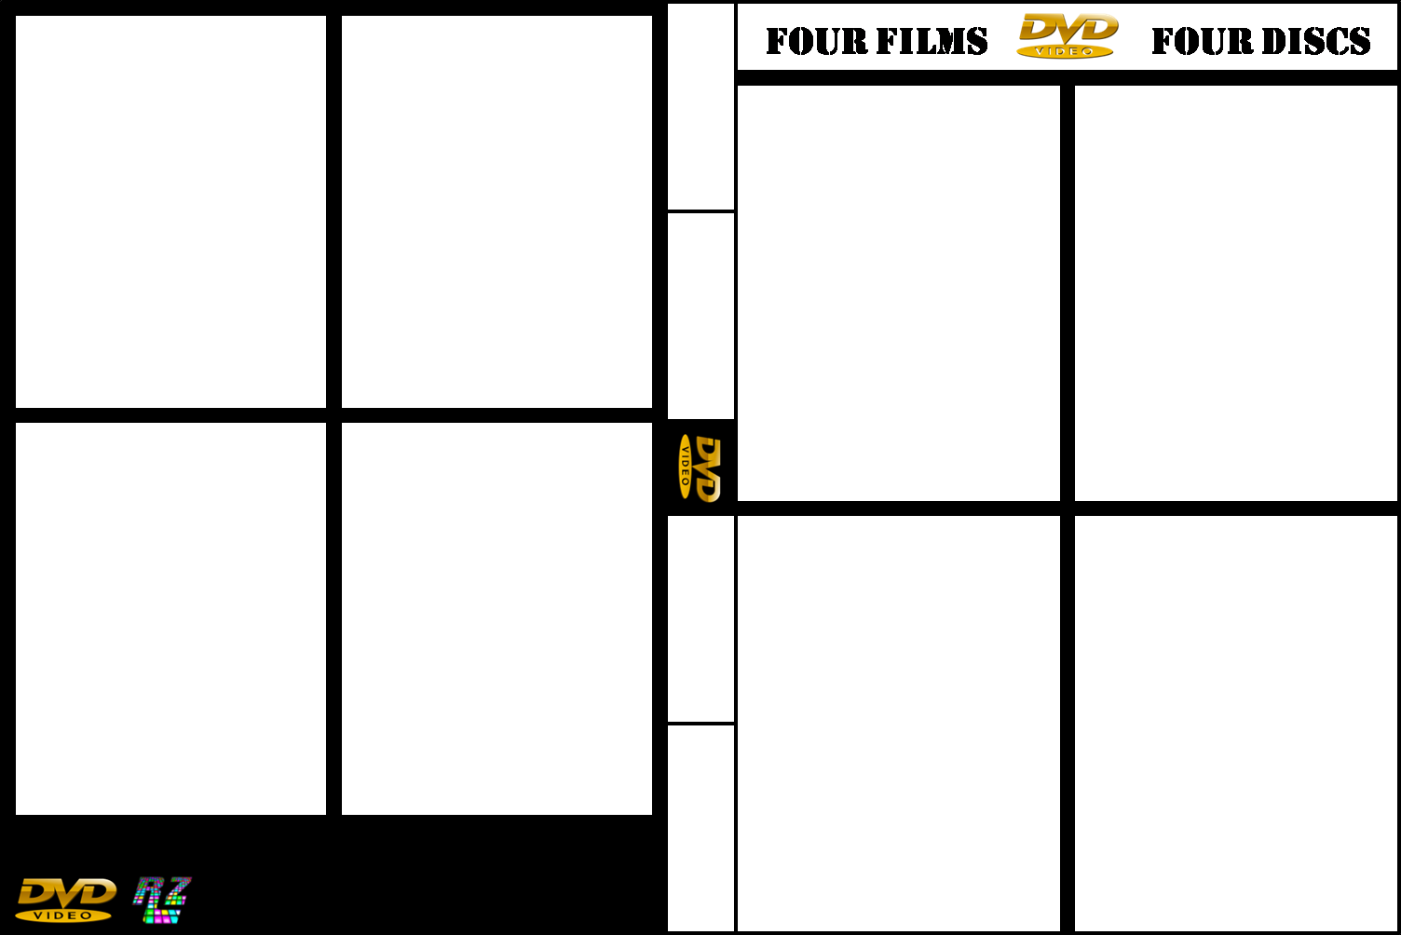










Notes:
Back Covers Image Size : Height – 7.2 cm / Width - 5.72 cm
Front Covers Image Size : Height – 7.62 cm / Width - 5.93 cm
Middle Cover Image Size : Height – 3.81 cm / Width - 1.27 cm
Remember Too Send The Image, To Back For The DVD Image. Free To Use No Copyright On This Image.

